Slide 1
A New Decade
A New Thing
Ludwig
02/02/19

Slide 2
Hebrew Year
It began on 29th September
5780
Peh
Mouth

Slide 3
1. God is A God of New Beginnings
Exodus 12:1-2
¹Now the Lord spoke to Moses and Aaron in the land of Egypt, saying,
(Nissan – 7th Month)
² “This month shall be your beginning of months; it shall be the first month of the year to you.
The 7th month became the first month of the year
This was the institution of Passover

Slide 4
Revelation 21:1
Now I saw a new heaven and a new earth, for the first heaven and the first earth had passed away.
Isaiah 41:18-19
¹⁸ “Do not remember the former things, Nor consider the things of old.
¹⁹ Behold, I will do a new thing, Now it shall spring forth; Shall you not know it? I will even make a road in the wilderness
And rivers in the desert.

Slide 5
2 Corinthians 5:17
¹⁷ Therefore, if anyone is in Christ, he is a new creation; old things have passed away; behold, all things have become new.

Slide 6
Ephesians 2:10
¹⁰ For we are His workmanship, created in Christ Jesus for good works, which God prepared beforehand that we should walk in them.
2. We were made for the NEW

Slide 7
Bereshit – In The Beginning
Leviticus 23:10-11
¹⁰ “Speak to the children of Israel, and say to them: ‘When you come into the land which I give to you, and reap its harvest, then you shall bring a sheaf of the firstfruits of your harvest to the priest. ¹¹ He shall wave the sheaf before the Lord, to be accepted on your behalf; on the day after the Sabbath the priest shall wave it.
Reshit:
Beginning, First-fruits,
First, Chief
Be:
Prefix Meaning “In”

Slide 8
3. There Is So Much More in God
Be-reshit – Reshit means beginning. It also is the word for Firstfruits.
Jesus is the Sheaf of Firstfruits (Resurrection)
Firstfruits Harvest points to the final and greater harvest found in the Feast of Tabernacles
Firstfruits/Reshit/Beginning has a greater to come. The Beginning is only the start of something. The full is to come.
Look up to Heavens (Vastness of God)
Notes:
A greater than Jonah and Solomon is here

Slide 9
Ephesians 3:20-21
²⁰ Now to Him who is able to do exceedingly abundantly above all that we ask or think, according to the power that works in us,
²¹ to Him be glory in the church by Christ Jesus to all generations, forever and ever. Amen.

Slide 10
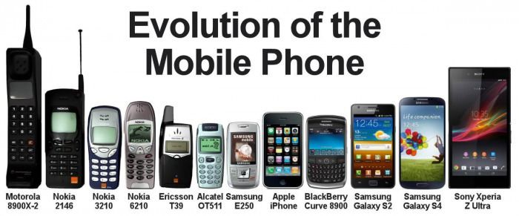
Last Decade (2010-2019)
New Decade (2020-2029)
Notes:
Joined Evangel in 2010
We don’t immediately prefer the new

Slide 11
John 2:1-11
¹ On the third day there was a wedding in Cana of Galilee, and the mother of Jesus was there.
² Now both Jesus and His disciples were invited to the wedding.
³ And when they ran out of wine, the mother of Jesus said to Him, “They have no wine.”
⁴ Jesus said to her, “Woman, what does your concern have to do with Me? My hour has not yet come.”
⁵ His mother said to the servants, “Whatever He says to you, do it.”

Slide 12
⁶ Now there were set there six waterpots of stone, according to the manner of purification of the Jews, containing twenty or thirty gallons apiece.
⁷ Jesus said to them, “Fill the waterpots with water.” And they filled them up to the brim.
⁸ And He said to them, “Draw some out now, and take it to the master of the feast.” And they took it.
⁹ When the master of the feast had tasted the water that was made wine, and did not know where it came from (but the servants who had drawn the water knew), the master of the feast called the bridegroom.

Slide 13
¹⁰ And he said to him, “Every man at the beginning sets out the good wine, and when the guests have well drunk, then the inferior. You have kept the good wine until now!”
¹¹ This beginning of signs Jesus did in Cana of Galilee, and manifested His glory; and His disciples believed in Him.
4. The New is Heavenly and Spiritual

Slide 14
Matthew 26:29
²⁹ But I say to you, I will not drink of this fruit of the vine from now on until that day when I drink it new with you in My Father’s kingdom.”
Points to the marriage supper of the Lamb and the second coming of Christ.

Slide 15
How Can Approach The New?
Jeremiah 31:31-33
³¹ “Behold, the days are coming, says the Lord, when I will make a new covenant with the house of Israel and with the house of Judah—
³² not according to the covenant that I made with their fathers in the day that I took them by the hand to lead them out of the land of Egypt, My covenant which they broke, though I was a husband to them, says the Lord.

Slide 16
³³ But this is the covenant that I will make with the house of Israel after those days, says the Lord: I will put My law in their minds, and write it on their hearts; and I will be their God, and they shall be My people.
What is God writing on your heart?

Slide 17
Matthew 4:1-11
Jesus said, it is written
The Devil also said, it is written
It is written in scripture, but is it written in our hearts?
2 Corinthians 3:3
³ clearly you are an epistle of Christ, ministered by us, written not with ink but by the Spirit of the living God, not on tablets of stone but on tablets of flesh, that is, of the heart.

Slide 18
Spiritual DNA
Psalms 139:16
Your eyes saw my substance, being yet unformed. And in Your book they all were written, the days fashioned for me, When as yet there were none of them.
What is the function of DNA?
What is written in our DNA?

Slide 19
Conclusion
God is the God of New beginnings
There is so much more in God
I am made for the New; not the old
God’s New is heavenly and spiritual
Open and engage with our heart and let God put His law in our minds and write it on our hearts
Be an open and willing vessel
Confess until the mind and heart are one

